Slide 1
Data Engineering Course
Assignment 2 : reading a Covide 19 cases from github repo and create a scoring png/scoring repost.csv/ store the report in postgreSQL.

Slide 2
Contents
Setup the docker-compose file.
Configurations.
Open airflow, psotgresql
Setup the postgresql database connection.
Run the DAG and check the pipeline

Slide 3
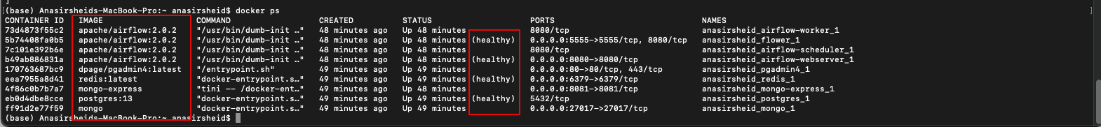
Setup the docker-compose file
The provided docker-compose file contains the configurations of all needed containers needed to create this assignment data pipeline:
Airflow containers (7 containers)- original compose file
Postgres PG admin visualization tool - added to the compose file
Before starting Airflow for the first time, You need to prepare your environment, i.e. create the necessary files, directories and initialize the database:
1. On your command shell type: docker-compose up airflow-init , The output should be: start_airflow-init_1 exited with code 0.
2. After the above step is done type: docker-compose up
3. On new terminal tyep: docker ps ,Here you must have all services healthey and you can see the different containers under this yaml file.
4. Remember that by this setup the airflow will create three directores on your pc ./logs, ./dags ,./ plugins
We will use the ./dags as a mapped directory to import and export the CSV/png files that will be used during this pipeline

Slide 4
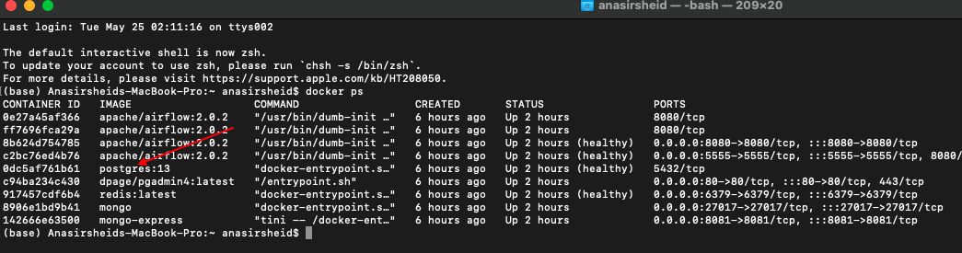
Configurations
After ensuring that all services are up and healthy we need to install the all necessary python package on the below containers:
On docker gui open cli terminals for all the three services Airflow Worker ,Airflow scheduler,Airflow flower.
On the terminals type: pip install faker, pip install matplotlib, pip install sklearn and any other needed package if the DAG is broken.
Now all services are up and healthy:
Put the assignment1.py file in the ./dag folder created by airflow.
Open a terminal type : docker ps ,here you will have all running containers.
On the same terminal locate postgres Container and idenity the service name
You will have the service name for postgresql to be used to setup the server

Slide 5
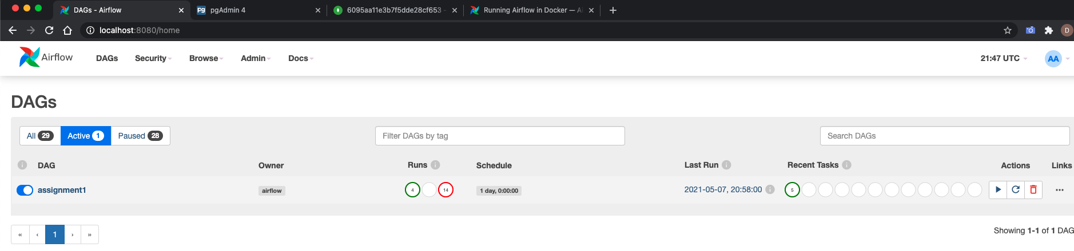
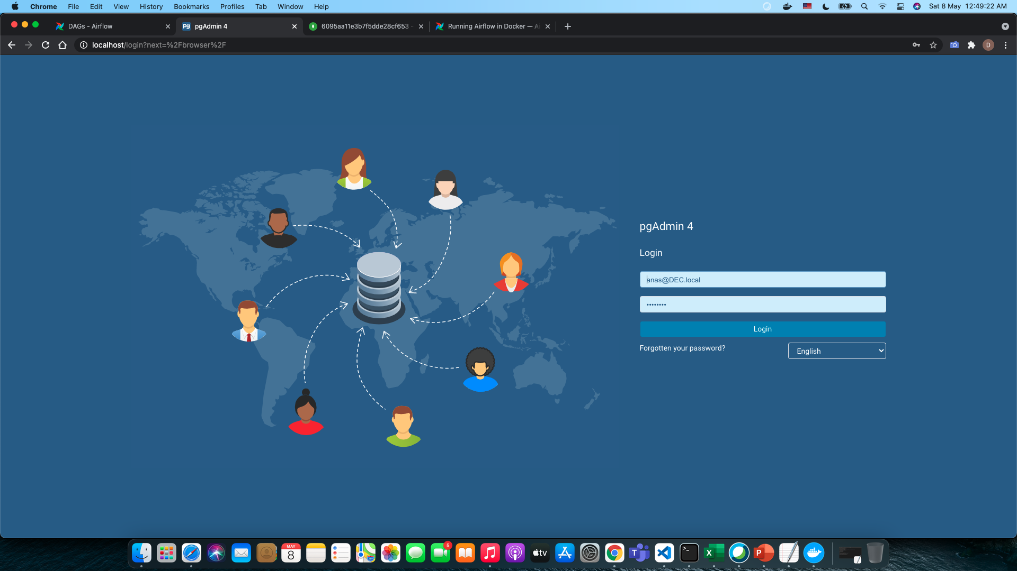
Open airflow, psotgresql, MongoDB.
To open the air flow type on your browser : localhost:8080.
To open postgressql type on our browser : localhost:80 , the username = anas@DEC.local, password = DECourse.

Slide 6
Setup the postgresql database connection.
According to the service name output of the configurations step you need to configure the connection to server of PostgreSQL database to be able to access it:
Username and password are set to airflow in docker file
After that you will be able to access the postgres data base and see the schemas and tables

Slide 7
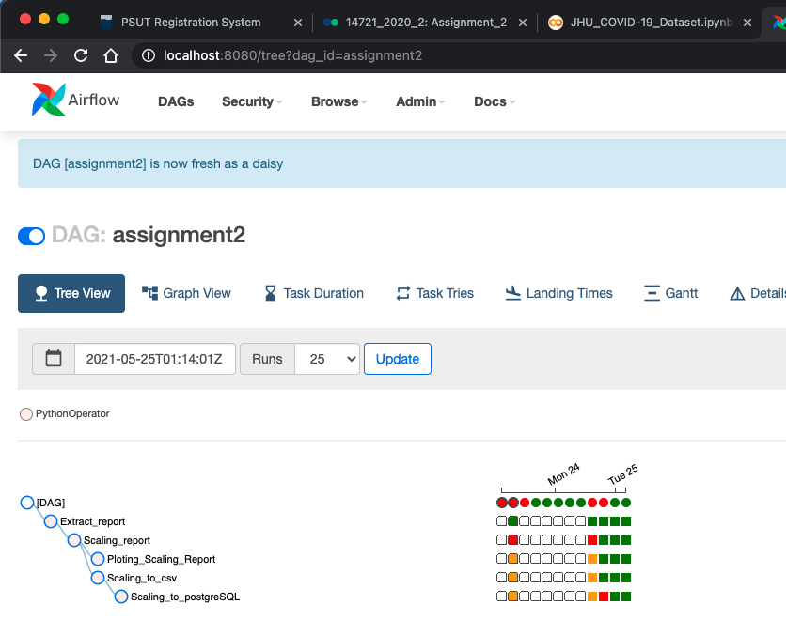
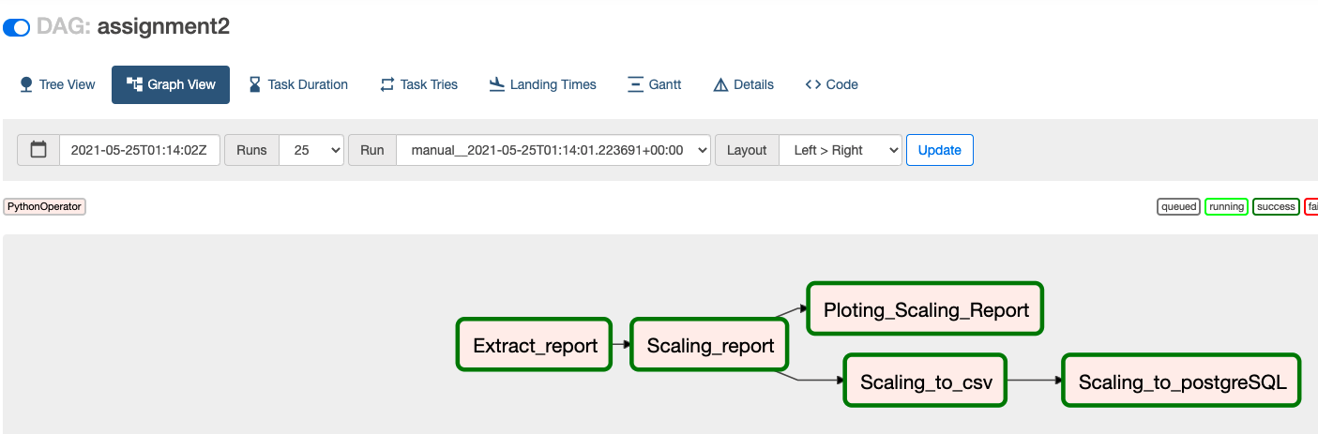
Run the DAG and check the pipeline-1
After completing the configurations step once you access the air flow you need to locate your DAG and ensure it is not broken: all steps in the MOP included to ensure the DAG assignment1 will not be broken unless you have a python package installation needed as illustrated before.
On your browser type : localhost:8080 the airflow window will open and you will be able to locate your DAG :

Slide 8
Run the DAG and check the pipeline-extract the report
After completing the configurations step and once you locate the assingment1 DAG you can run it and ensure it is set to green all the ways
According to the first DAG the Extract report will get the data.csv from the github repo that have the updated daily cases and get the time series and append it with the cases , here I have saved collected data as Csv to be used for the next Dag

Slide 9
Run the DAG and check the pipeline-3- scaling report
The second Dag will perfume scaling for the generated report

Slide 10
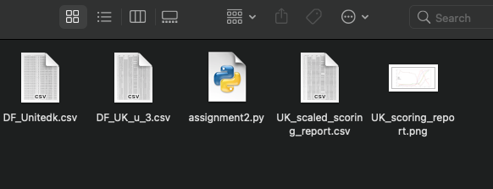
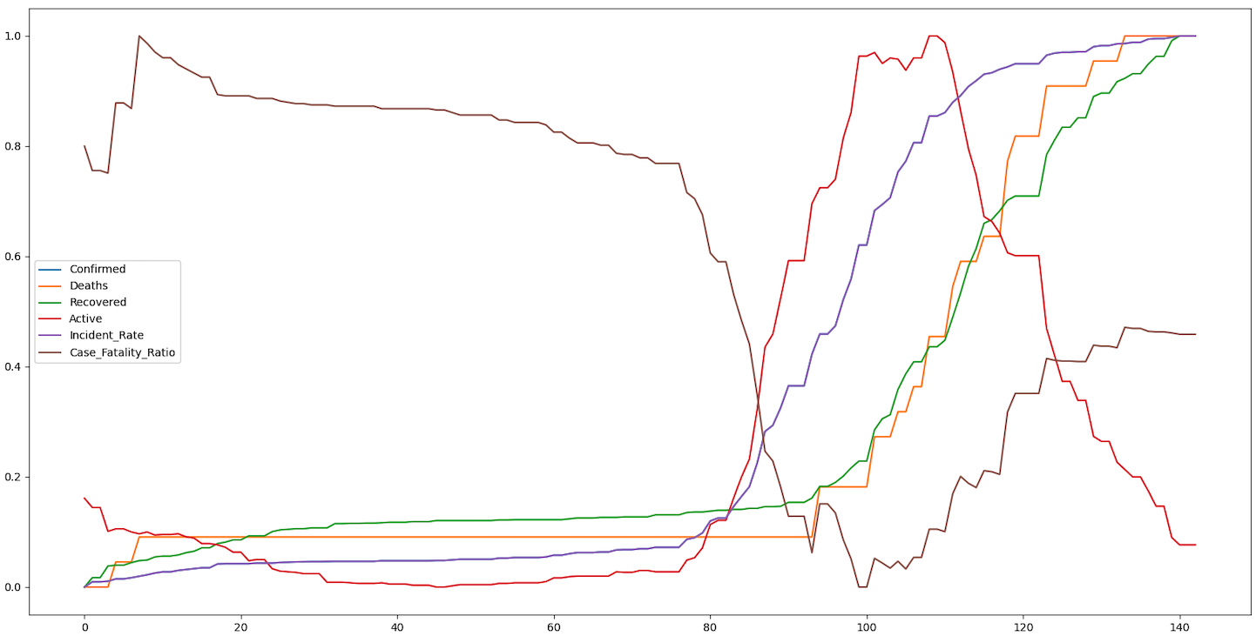
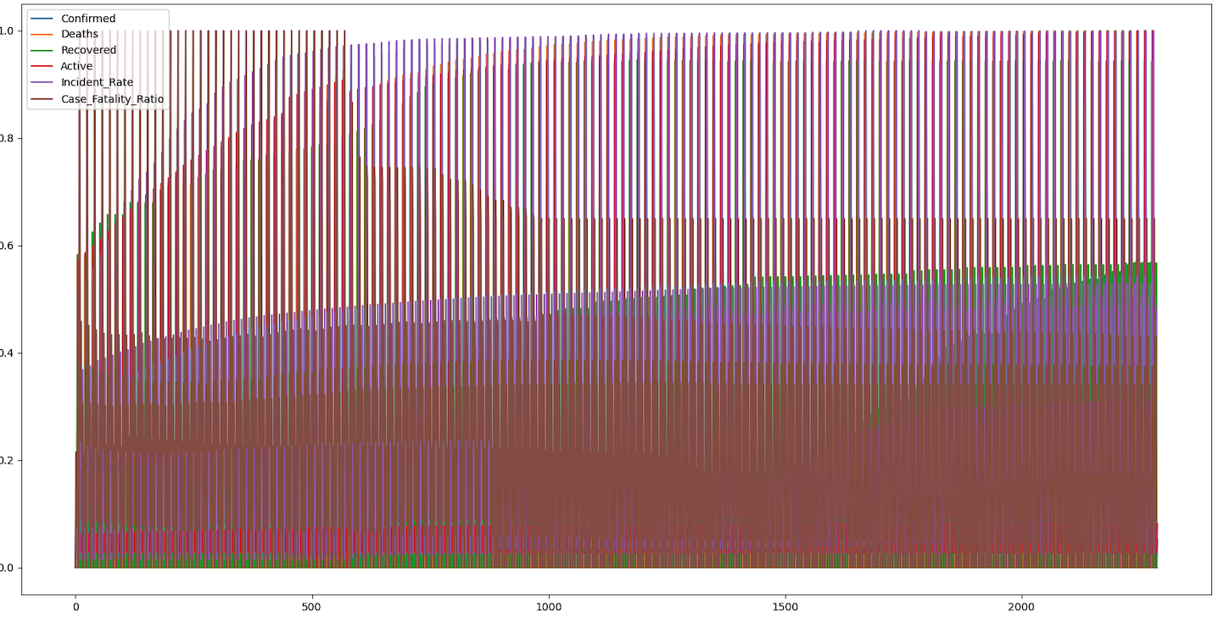
Run the DAG and check the pipeline-4- ploting and create a CSV file
The third Dag will plot the results and save it as png , here I have selected one province in United Kingdom as selecting multiple provinces will generate a congested graph, and the png will be saved in the mapped drive of the airflow , here I selected the file to be ./dags
Also the generated date will be stored as CSV in the same directory ./dags
One province plot . All UK

Slide 11
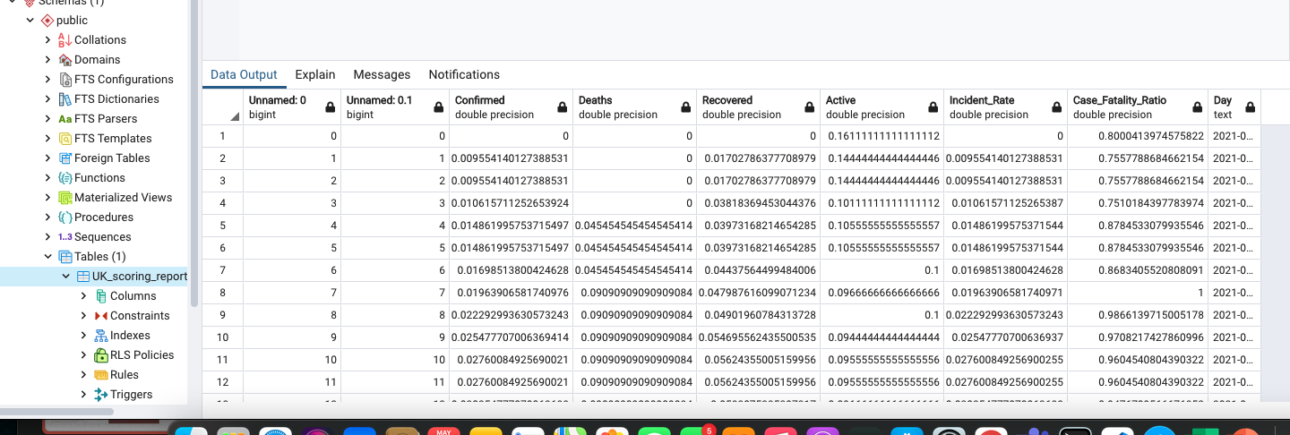
Run the DAG and check the pipeline-5- save the report in PostgreSQL
The last step the designed Dag will save the report in PostgreSQL database.

Slide 12
Thank You

